Slide 1
Principles of Programming using C
Prof Somesh Nandi
Assistant Professor –Dept of AIML RVCE.

Slide 2
Unit -1
Logical Reasoning and Algorithmic Problem Solving: Skill development – Examples related to Arithmetical Reasoning and Analytical Reasoning.
Introduction to Programming: Design and Implementation of efficient programs. Program Design Tools: Algorithms, Flowcharts and Pseudo codes. Types of Errors.
Introduction to C: Introduction, structure of a C program, writing the first program, Files used in a C program. Compiling and executing C Programs using comments, C Tokens, Character set in C, Keywords, Identifiers, Basic Data Types in C, Variables, Constants, I/O statements in C. Operators in C, Type conversion and type casting,scope of variables.

Slide 3

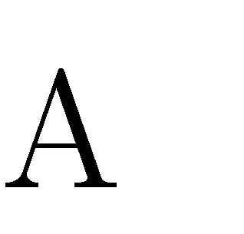
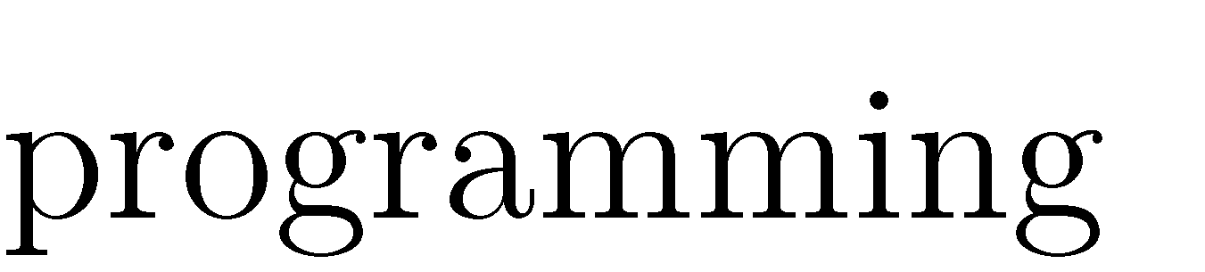
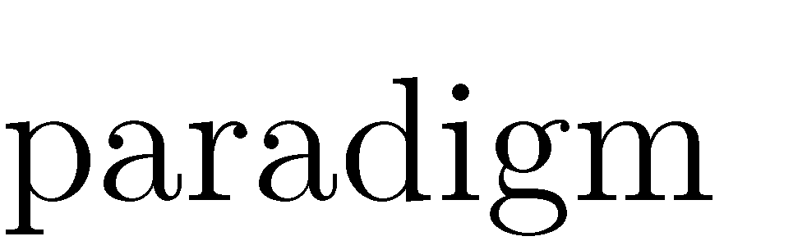
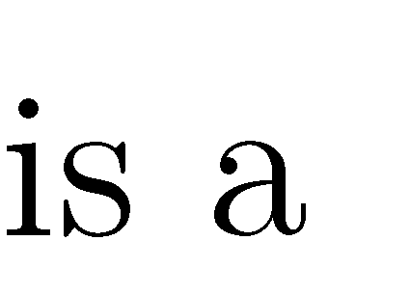
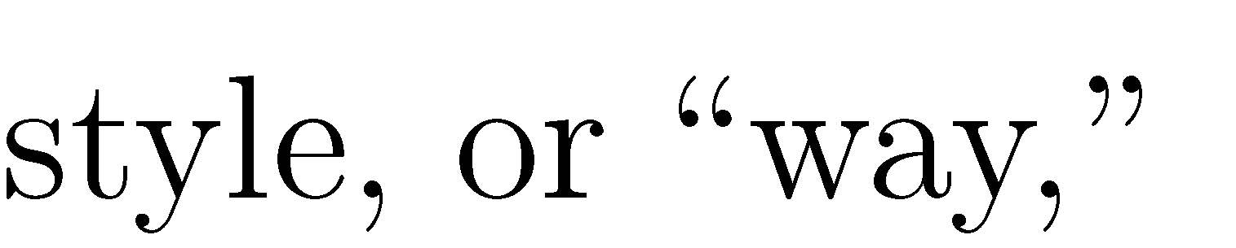
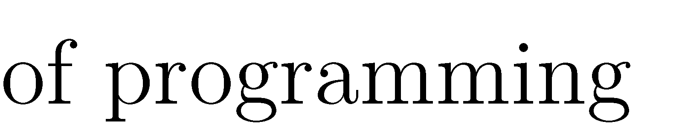
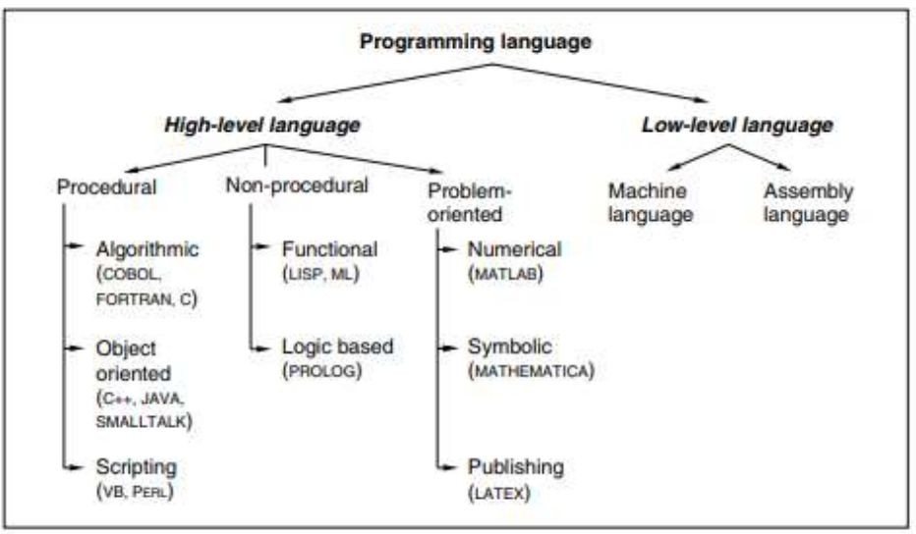
.

Slide 4
Programming Paradigms:
Low-level languages: Assembly languag
Each assembly language instruction accomplishes only a single operation and the coding for a problem is at the individual instruction level.
The high level programming languages may also be categorized into three groups— procedural, non-procedural, and problem oriented.
Procedural programming languages- Algorithmic, Object oriented and Scripting
Non Procedural Languages: Rule based languages or logic programming languages
Problem-oriented languages: MATLAB is a very popular language among scientists and engineers
.

Slide 5
INTRODUCTION
C was developed in the early 1970s by Dennis Ritchie at Bell Laboratories
C was initially developed for writing system software
Today, C has become a popular language and various software programs are written using this language.
Many other commonly used programming languages such as C++ and Java are also based on C
Characteristics of C
A high level programming language
Small size. C has only 32 keywords. This makes it relatively easy to learn
Makes extensive use of function calls
C is well suited for structured programming. In this programming approach,
Stable language.
Quick language
Facilitates low level (bitwise) programming
Supports pointers to refer computer memory, array, structures and functions.
C is a core language
C is a portable language.
C is an extensible language

Slide 6


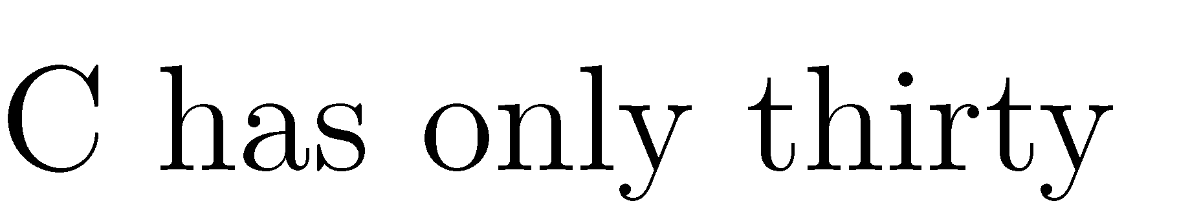

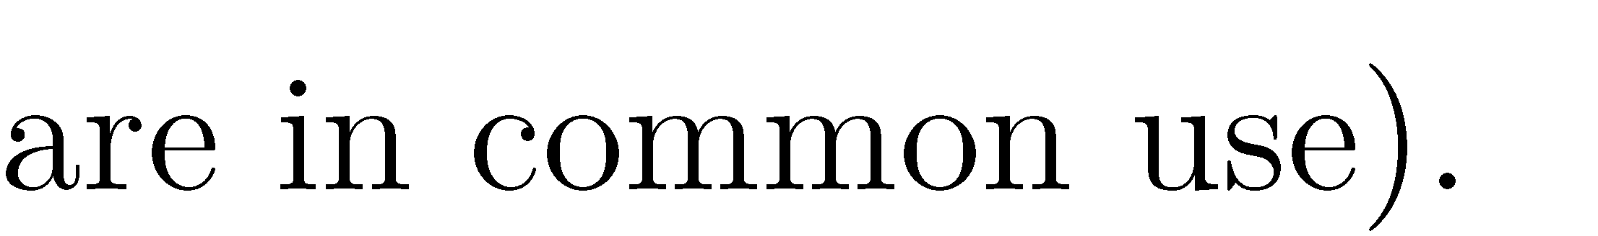
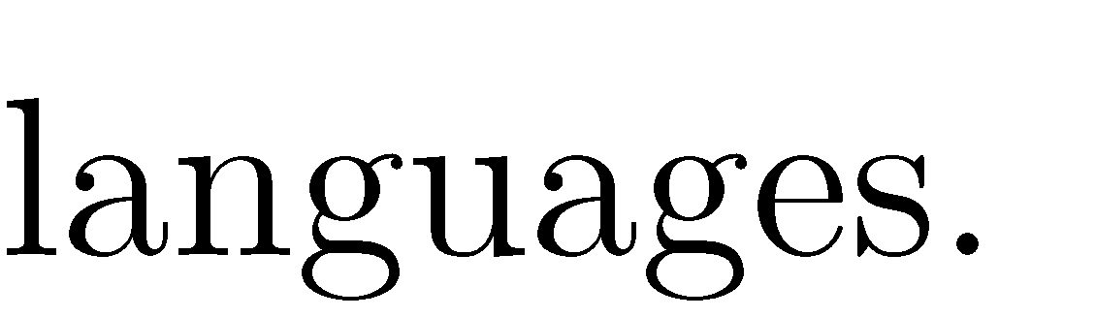

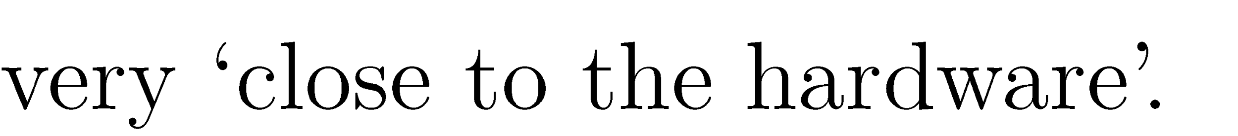
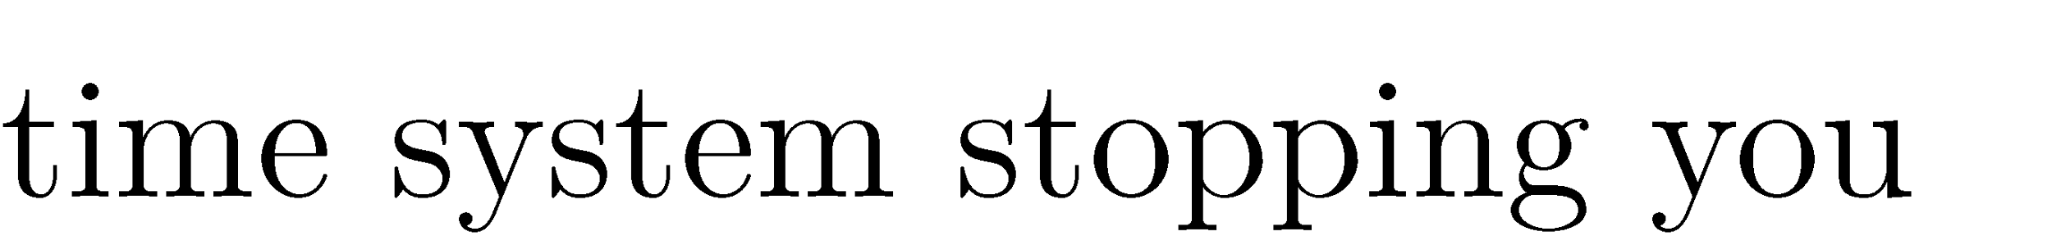
Go, Change the World
•
•
•
•

Slide 7
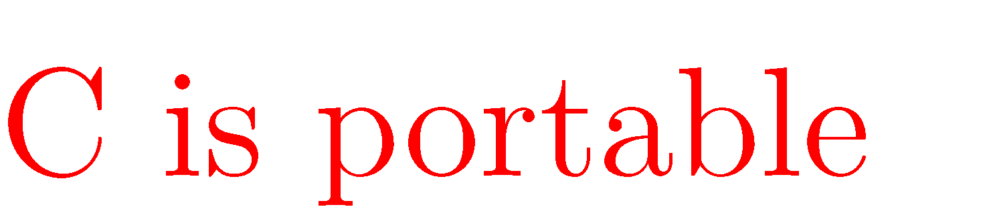
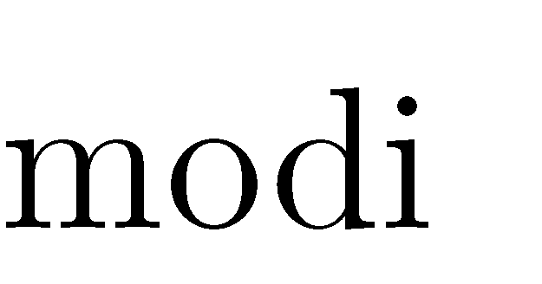
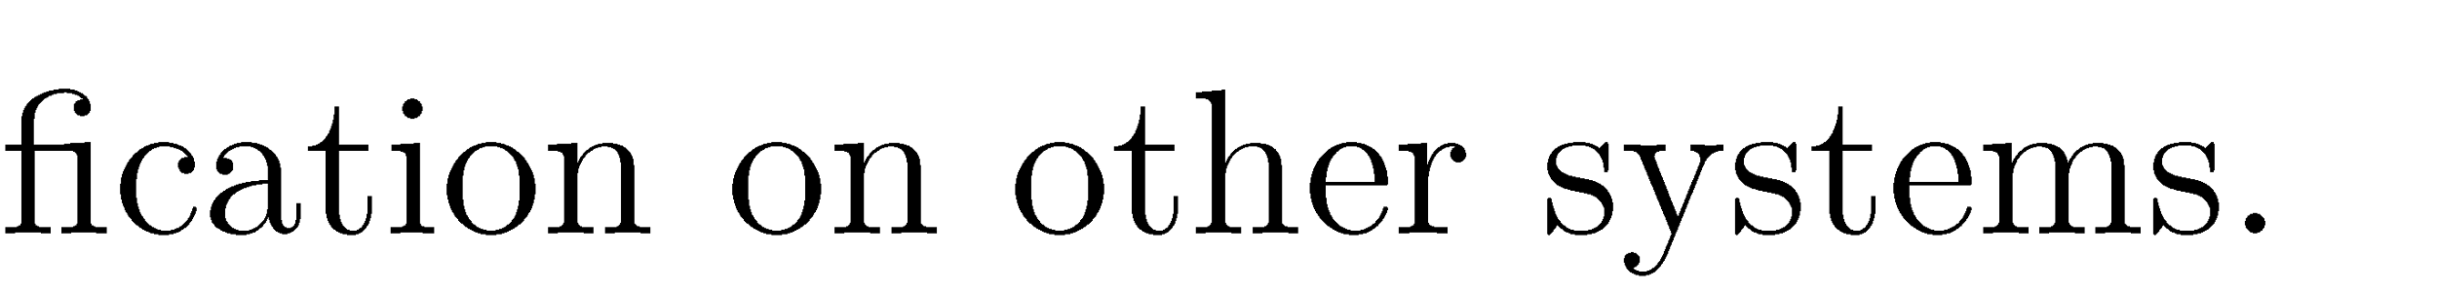
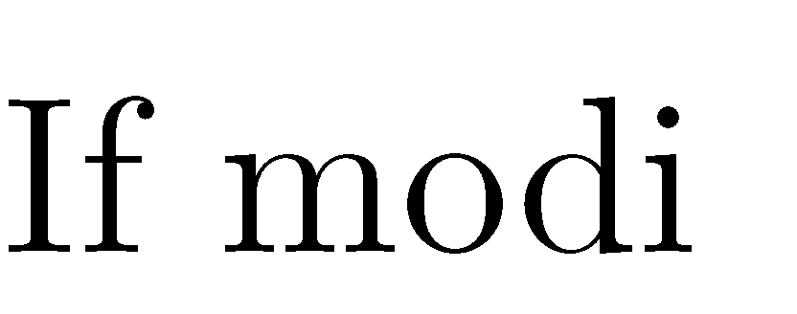
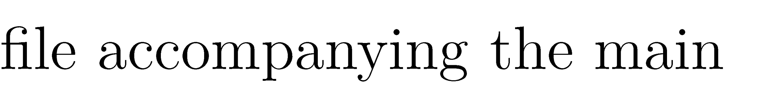
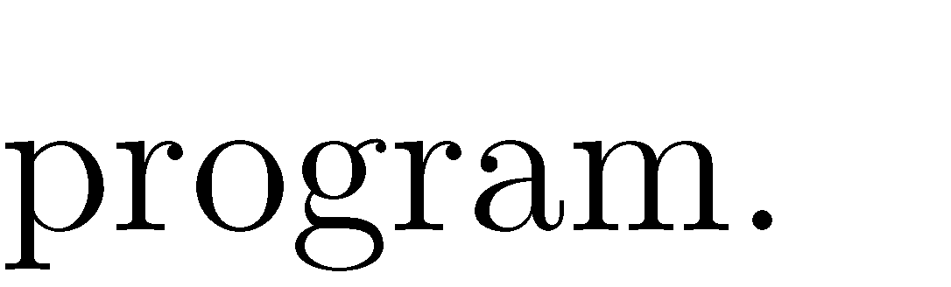
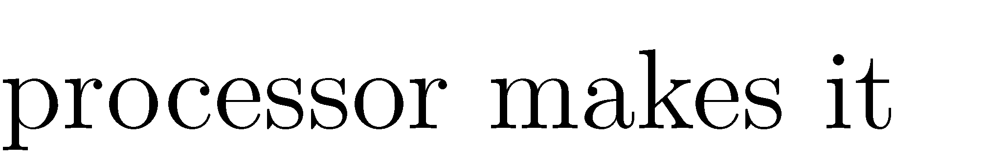
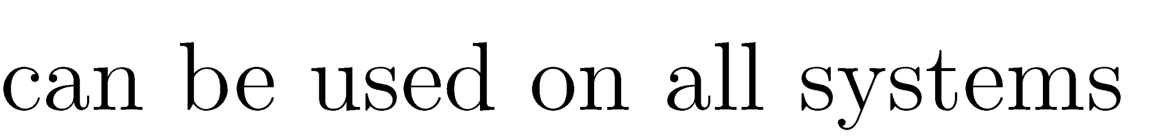
Go, Change the World
•
•
•
•
•

Slide 8

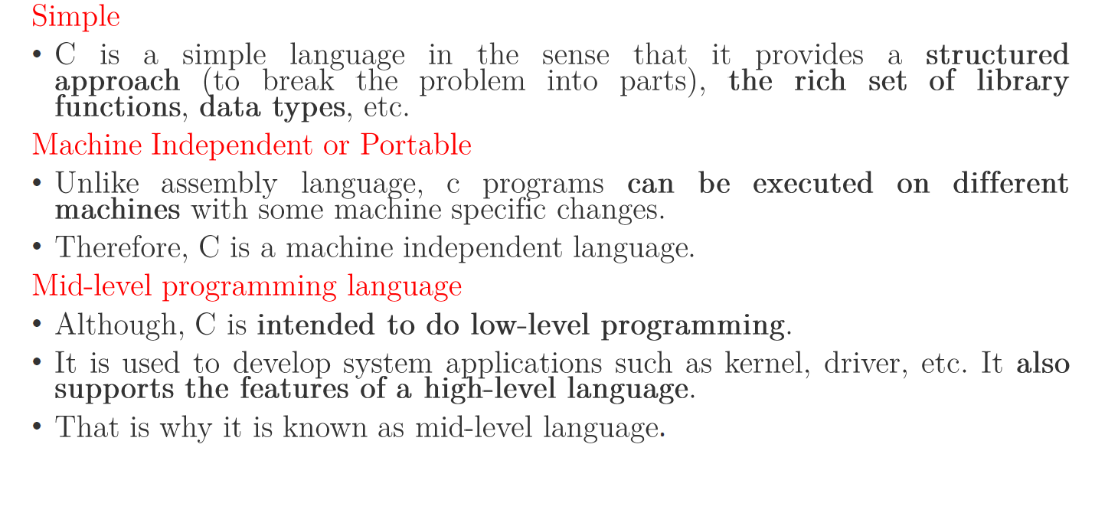
Go, Change the World
.

Slide 9
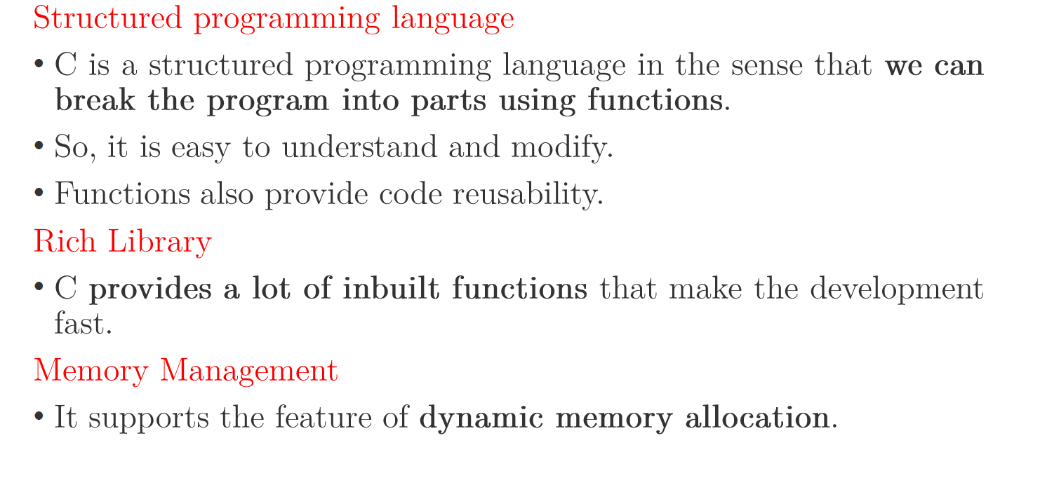
Go, Change the World
.

Slide 10

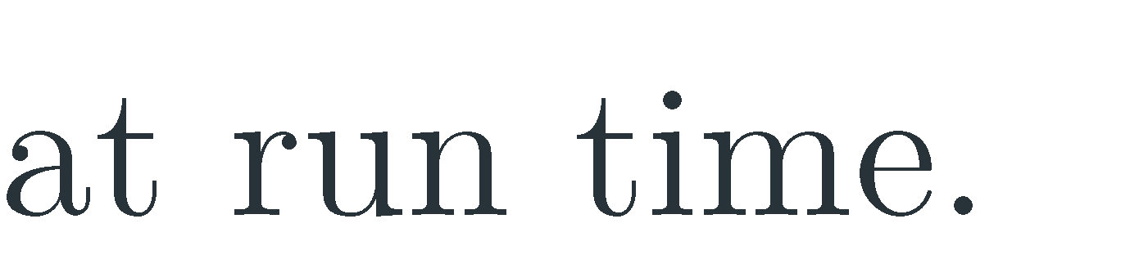


Go, Change the World
•
•

Slide 11
Advantages of C programming language
Mainly C programming is utilized for the Development of system software and Desktop application. Some C programming applications are given below.
Operating Systems
UNIX was the first OS developed using a high-level programming language designed in the C programming language. Later on, Microsoft Windows and different Android applications were scripted in C language
GUI (Graphical User Interface)
Adobe Photoshop is one of the most popular photo editors since olden times. It was designed with the help of the C language only. Moreover, Illustrator and Adobe Premiere were also designed using C
Compiler Design
One of the common uses of the C programming language was the production of compilers. Compilers for many other languages were designed by keeping in mind the relationship of C with low-level languages, making it more comfortable to be understandable by the machine
Gaming and Animation
Since the C language is comparatively faster than Python or Java, as it is compiler-based, it also gains its reputation in the gaming sector. Some of the most simple games are coded in C languages, such as The Dino game, Tic-Tac-Toe, The Snake game, and many more

Slide 12

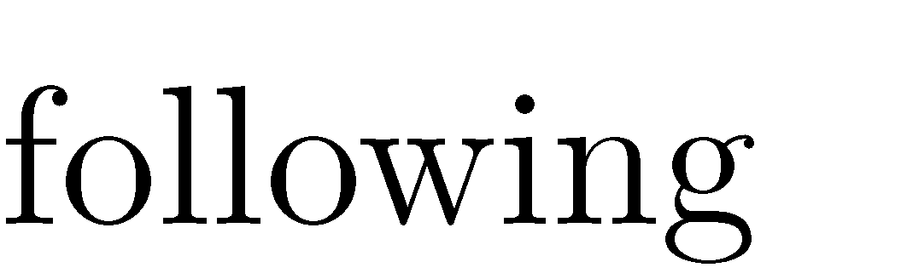
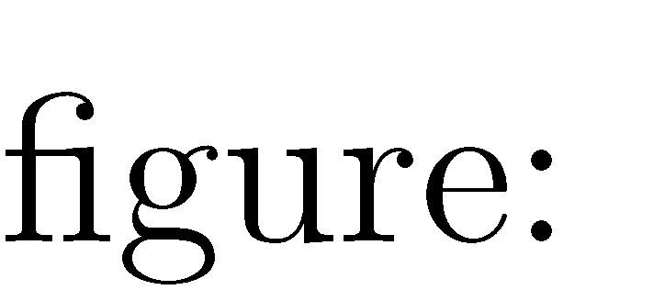
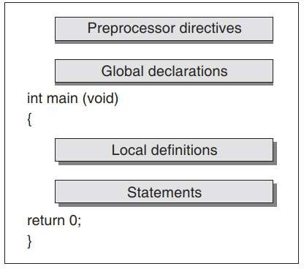
Go, Change the World

Slide 13
.
A C program is composed of the pre-processor commands. A global declaration and one or more functions.
The pre-processor directives contain special instruction that indicate how to prepare the program for compilation.
Most commonly used pre-processor command is include.
The basic idea behind the global declaration is that they will be visible to all parts of the program .
Including main() is divided into the local declarations and statements.
Data Declared within the function are known as the local declarations as the data will be visible only within that function.
From this structure, we can see that c program can have many functions depending on the tasks and each function may have many statements return in particular order

Slide 14
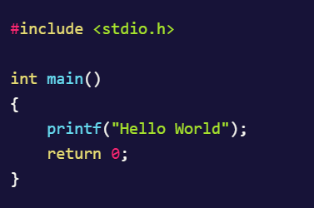
FIRST C PROGRAM
The different parts of a C Program:
Pre-processor
Header file
main() function
Variables in C
Statements & expressions in C

Slide 15
Pre-processor
The #include is the first statement of any C program. It is known as a pre-processor.
The task of a pre-processor is to initialize the environment of the program, i.e. to link the program with the header files required.
As its name suggests, this line of code is responsible for doing pre-processing, before the actual code (logic) is executed.
When we say #include<stdio.h>, it is to inform the compiler to include the stdio.h header file which is the standard I/O library into the program before executing the program.
The #include is not the only pre-processor. Whenever you see any piece of code starting with a # symbol, that means it's a pre-processor in the C language.

Slide 16
Header file
A Header file is a set or collection of built-in(readymade) functions, that we can directly use in our program.
Header files contain definitions of the functions which can be used in any C program
To use a header file you must import it into your program by using pre-processor #include statement along with the name of the header file.
There are some standard header files that come along with default C installation, like stdio.h header file.
All header files will have .h extension

Slide 17
Main Pgm
The C program starting point is identified by the word main().
This informs the computer as to where the program actually starts.
The parentheses that follow the keyword main indicate that there are no arguments supplied to this program (this will be examined later on).
The two braces,{}, signify the begin and end segments of the program.
In general, braces are used throughout C to enclose a block of statements to be treated as a unit. COMMON ERROR: unbalanced number of open and close curly brackets!

Slide 18
Header file
The printf() Function
The printf() is a function that is used to print(show) anything on the console as output.
This function is defined in the stdio.h header file, which we have included in our C program.
Return Statement
A return statement is used to return a response to the caller function.
It is generally the last statement of any C language function.
Semicolon
It is important to note that every statement in C should end with a semicolon(;).
If you miss adding any semicolon, the compiler will give an error.
Semicolon (;) is called the statement terminator in C programming

Slide 19
FILES USED IN A C PROGRAM
Files in a C program
Source code file
The source code file contains the source code of the program.
The file extension of any C source code file is “.c”.
This file contains C source code that defines the main function and maybe other functions.
The main() is the starting point of execution when you successfully compile and run the program.
Header Files
When working with large projects, it is often desirable to make sub-routines and store them in a different file known as header file. The advantage of header files can be realized when
a) The programmer wants to use the same subroutines in different programs.
b) The programmer wants to change, or add, subroutines, and have those changes be reflected in all other programs.
Conventionally, header files names ends with a “.h” extension and its name can use only letters, digits, dashes, and underscores.
While some standard header files are available in C, but the programmer may also create his own user defined header files. Eg String.h, math.h, conio.h
Source File
Header File
Object File
Executable File

Slide 20
FILES USED IN A C PROGRAM contd.
Object Files
Object files are generated by the compiler as a result of processing the source code file.
Object files contain compact binary code of the function definitions.
Linker uses this object file to produce an executable file (.exe file) by combining the of object files together.
Object files have a “.o” extension, although some operating systems including Windows and MS-DOS have a “.obj” extension for the object file.
Binary Executable File
The binary executable file is generated by the linker.
The linker links the various object files to produce a binary file that can be directly executed.
On Windows operating system, the executable files have “.exe” extension.

Slide 21
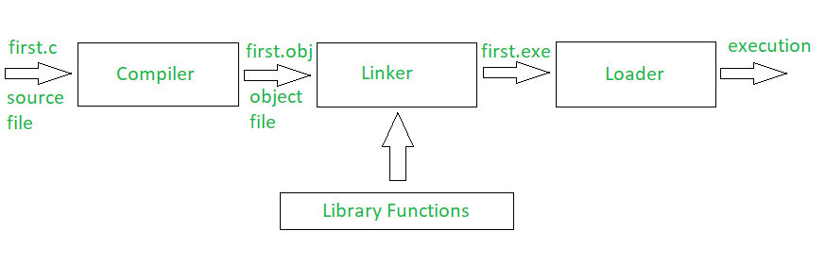
Compiling and Executing C program
Complier : Translates the Source file to Object files ( It checks for the error , if no error are present in the program, it will generate the object file.
Linker : Library functions are not part of any c program, they are part of c software, so it is necessary to link them to the program and linker does this job and produces exe file.
Loder : Loads the exe file in the main memory and tells the CPU , starting point of the program where it is loaded

Slide 22
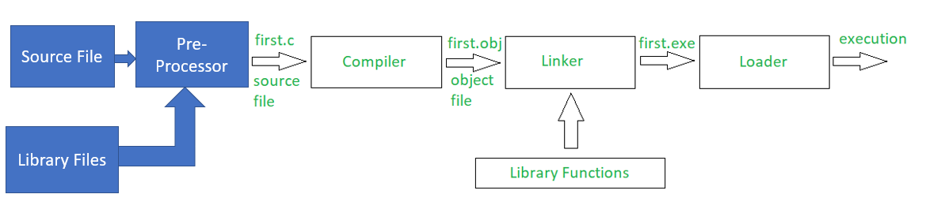
Pre-Processing before compilation
There are two types of source files in c program , one is main.c and other is .h files.
The compilation process happens in two steps.
The C program, starting with # is not actually written in C but in the pre processor language.
It will be given as input to the pre processor, which will generate clean source file, which will be given for compilation.

Slide 23
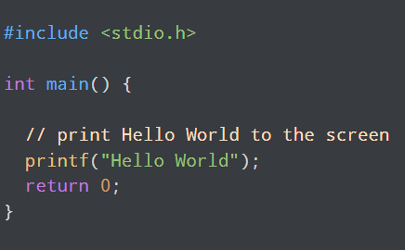
Using Comments in C Program
In programming, comments are hints that a programmer can add to make their code easier to read and understand. For example
Here, // print Hello World to the screen is a comment in C programming. Comments are completely ignored by C compilers

Slide 24
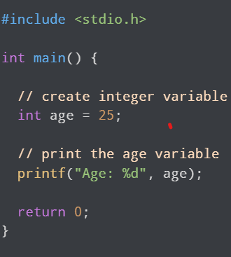
Types of Comments
There are two ways to add comments in C:
1. // - Single Line Comment
2. /*...*/ - Multi-line Comment
1. In C, a single line comment starts with //. It starts and ends in the same line and there is no need to specify the end of the comment
For example

Slide 25
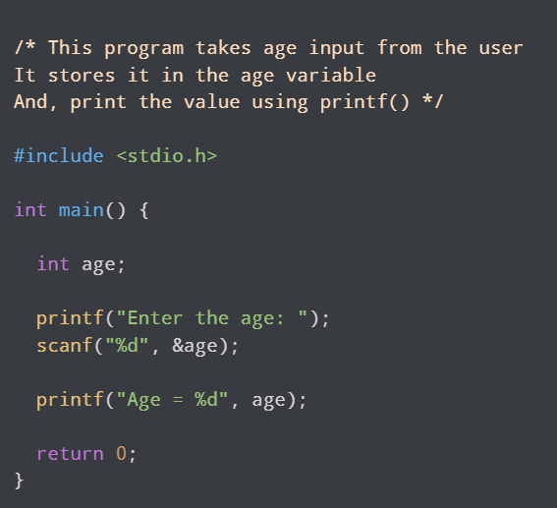
Types of Comments
2. /*...*/ - Multi-line Comment
To write multi-line comments, we use the /*....*/ symbol. For example,

Slide 26
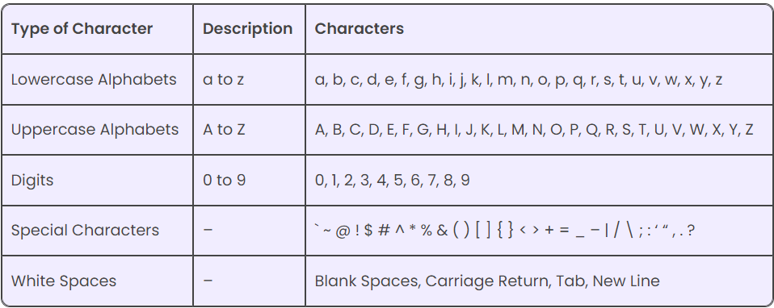
Character Set in C
character set refers to a set of all the valid characters that we can use in the source program for forming words, expressions, and numbers

Slide 27
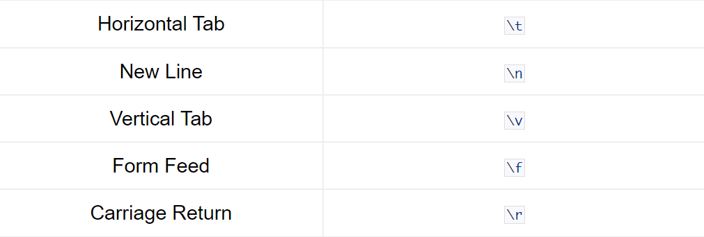
White Space - Character Set in C
These characters are used to print the blank space on the screen

Slide 28
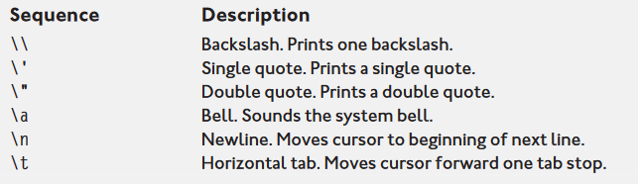
Escape Sequence in C
An escape sequence in C language is a sequence of characters that doesn't represent itself when used inside string literal or character

Slide 29
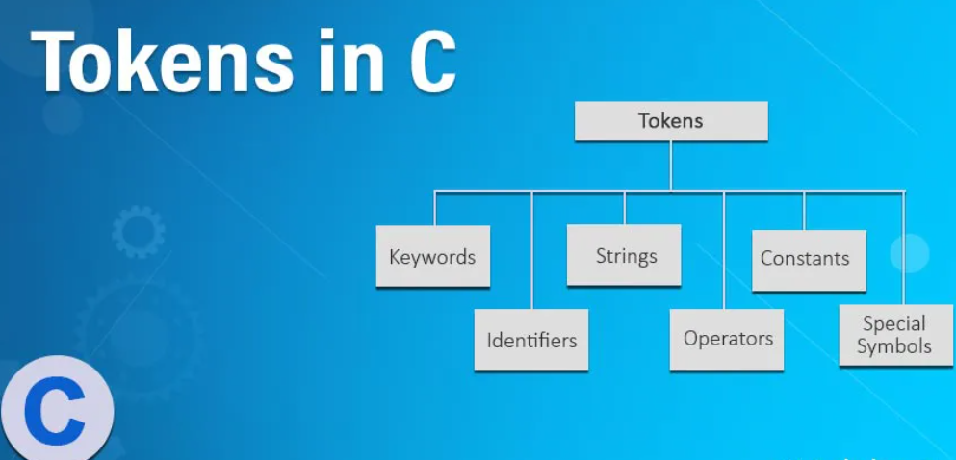
C –Tokens
The words formed from the character set are building blocks of C and are sometimes known as tokens. These tokens represent the individual entity of language.
There are Six Types of Tokens used in C language

Slide 30
Identifier
Identifier in C language is used for naming functions, variables, structures, unions, arrays, etc.
The identifier is user-defined words. These identifiers can be composed of uppercase, lowercase letters, digits, underscore. Identifiers never used for keywords.

Slide 31
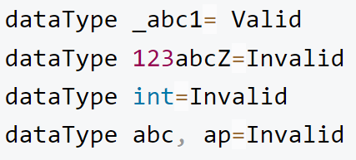
Rules to construct Identifiers
The first character should be either alphabet or underscore and then followed by any character, digit, no two successive underscore.
Identifiers are case sensitive as there is A and a treated as different.
Commas and blank space are not allowed
Keywords can’t be used for identifiers.
The length of the identifiers should not be more than 31 characters.
Naming convention should understandable to the user

Slide 32
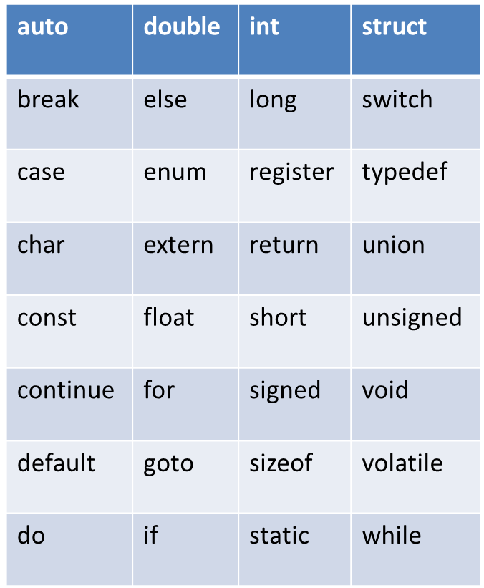
Keywords
Keywords are nothing but system defined identifiers.
Keywords are reserved words of the language.
They have specific meaning in the language and cannot be used by the programmer as variable or constant names
C is case sensitive, it means these must be used as it is
32 Keywords in C Programming

Slide 33
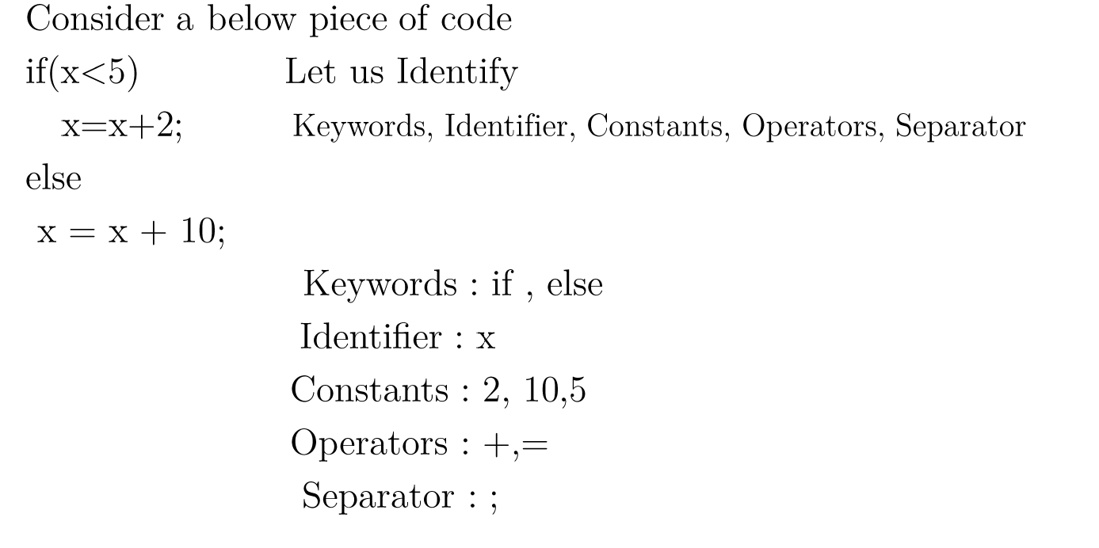
Quick Test

Slide 34
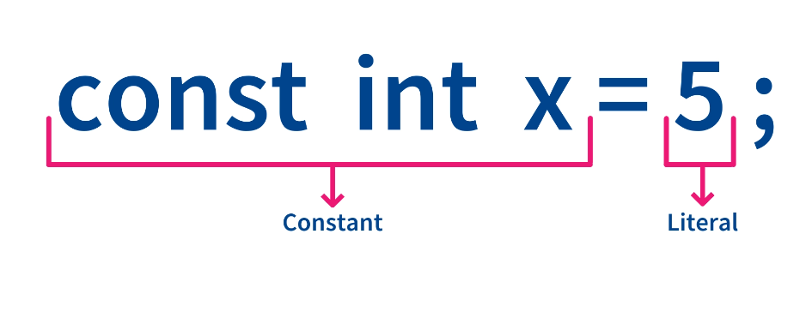
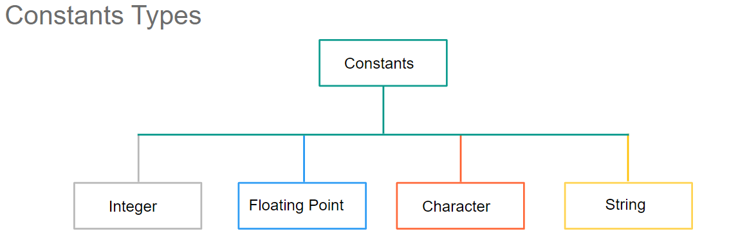
Constants
There might be some data whose values remain constant throughout the program execution. Such variables are known as Constant Variables.
The values assigned to the variables are known as the literal
A number, a character, a string of characters, an array, a structure, a union, a pointer, can be set as a constant

Slide 35

Integer Constants
An integer constants consists of sequence of Integer numbers from 0 to 9.
Decimal points, black spaces, commas cannot be included within an integer constants.
An Integer constants can either be positive or negative or zero.
The number without sign can be assumed as positive
Integer constants can be classified into 3 ways . They are
Decimal Integer Constants.
Octal Integer Constants.
Hexadecimal Integer Constants

Slide 36
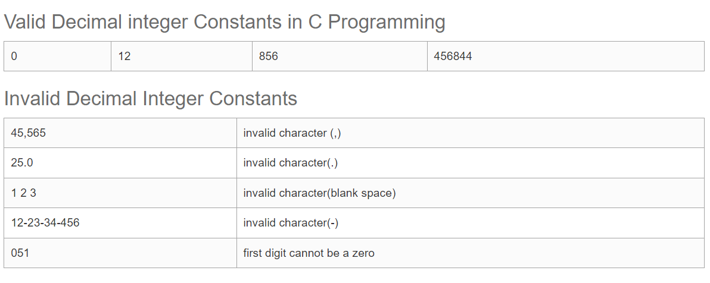
Decimal Integer Constants
A Decimal integer constants consist of any combination of digits from 0 to 9. A Decimal integer constants can contain two or more digits, but first digit should not be 0. Base value of decimal integer is 10.

Slide 37
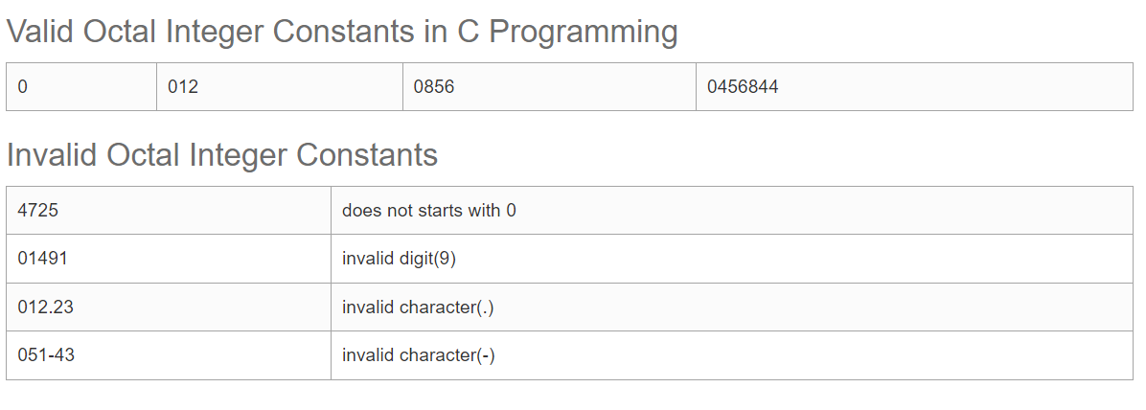
Octal Integer Constants
An Octal integer should starts with 0 in order to identify the constant as an octal integer number.
An Octal integer constants consist of any combination of numbers between 0 to 7. Base value of Octal integer constants is 8.

Slide 38
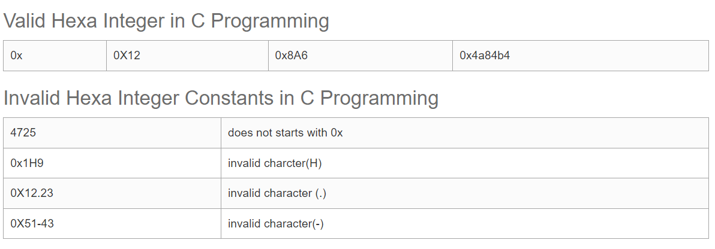
Hexadecimal Integer Constants
A Hexadecimal integer constants can be a combination of any numbers in the range of 0 to 9 and a to f or A to F.
Here A to F denotes 10 to 15. A Hexadecimal integer constants should starts with either 0x or 0X.
Base value of Hexadecimal integer constants is 16.

Slide 39
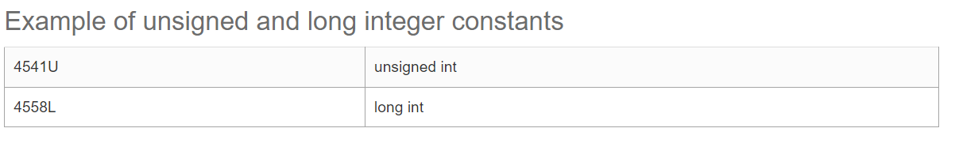
Unsigned or Long Integer Constants
Unsigned or Long Integer Constants may exceed the range of Integer. Unsigned or Long Integer Constants are identified by the suffix u or l. Here
u represents unsigned int.
L represents long int.

Slide 40
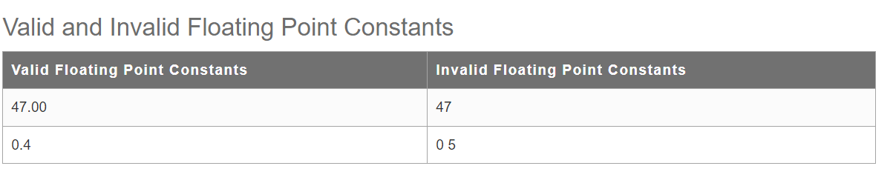
Floating point constant
A floating point constant consist of integer part, decimal point and fractional part.
A floating point constant contains exponential field e or E followed by an integer.
A normal decimal point value will be treated as double until a suffix f is added to the decimal point value, if suffix (f or F) it will be treated as float
A double is a data type in C language that stores high-precision floating-point data or numbers in computer memory
Decimal point value using double will be more accurate than float. Adding suffix l or L to the Decimal point value will be treated as long double.
A floating point constant with an exponent is essentially the same as scientific notation, except that base 10 is replaced by e or E.
Exponential notation is useful in representing the numbers whose magnitudes are very large or very small.
0.12 --- Double
0.12f ---- Float
0.12F -----Float
0.12l---- Long Double
0.12L --- Long Double

Slide 41
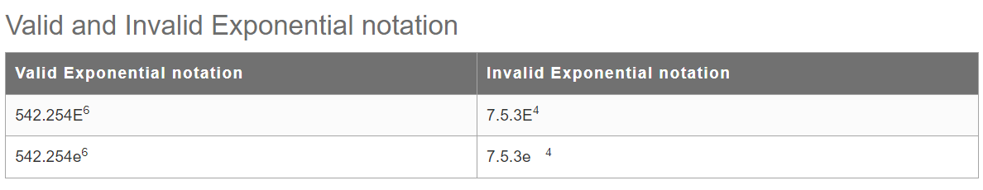
What is Mantissa and Exponent?
Consider the number 257.47. This can also be return as 0.25747E³. The sequence of digits after decimal point (25747) is a mantissa. The power of E (3) is known as exponent.

Slide 42
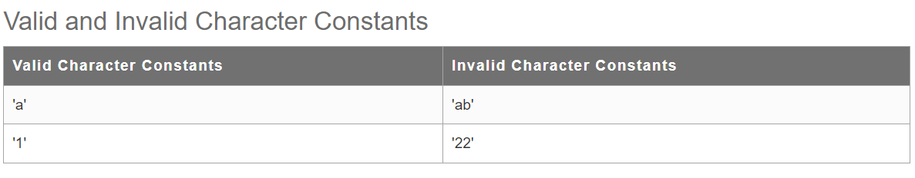
Character constant
A character constant is a single character enclosed within single quotes ' ‘.
A character constant also represented with a single digit or a single special character or white space enclosed within a single quotes.
All PC make use of ASCII(American Standard Code for Information Interchange) character set, where each integer character is numerically encoded.
A character constant occupies a single byte.

Slide 43
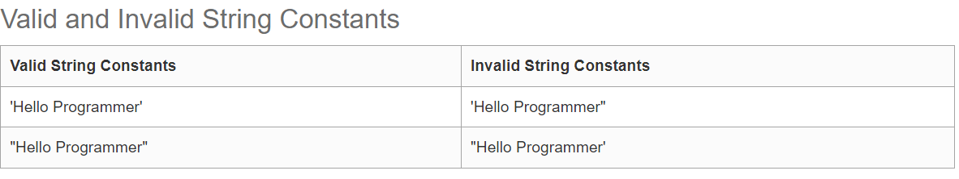
String Constants
A string constant is a sequence of characters enclosed within double quotes " ". The Characters may consists of letters, digits, escape sequences and spaces. A string constant always ends with null (/0). A string constant occupies a two bytes

Slide 44
Declaring Constants
In the C programming language, A variable can be used as a constant by the following methods:
Using const keyword.
Using the #define preprocessor.
const Keyword
Using the const keyword is the most basic and simplest way to declare a constant
You just have to add a const keyword preceding the declaration of the variable.
While using the const keyword to define a constant one should keep in mind that the constant has to be initialized at the beginning of the program and cannot be changed later.
Syntax :const datatype variable-name =value;
Eg : const float pi = 3.14;

Slide 45
Declaring Constants
Using the #define preprocessor.
#define preprocess, we have to keep in mind a few things.
The constant should be declared before the main function.
The common mistakes committed during the initialization of constant using #define preprocessor is adding a semicolon at the end of the declaration.
Semicolons should not be added at the end of the declaration of a constant using the #define preprocessor.
Syntax : #define constant_name value
Eg: #define pi 3.14

Slide 46
Rules for Defining Constants
Constant names are usually return in the capital letters to visually distinguish them from the other variables
No Blank space are allowed between #symbol and define keyword
Blank space must be used between # define and constant name and constant name and value
#define is the pre processor complier directive and not a statement , so it doesnt end with semicolon.
.

Slide 47
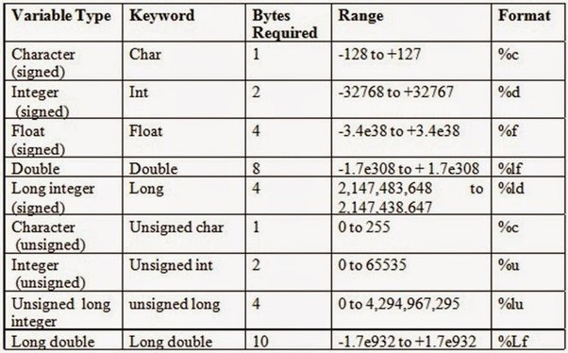
Basic Data Types
.
The basic data types are integer-based and floating-point based. C language supports both signed and unsigned literals

Slide 48
Variables
Variable is basically nothing but the name of a memory location that we use for storing data.
C supports two kind of variables : Numeric and Character Variables.
Syntax to declare variables : type variable_list
Eg: int salary
Numeric Variables : Used to store either integer or float point values and it supports both signed and unsigned modifiers.
Eg : int a=10,b=20;//declaring 2 variable of integer type (C allows decalring two variables of same type in one line) and float f=20.8;
Character Variables : Variables that have ASCII Characters defined inside the single quote.
Eg : char c='A';

Slide 49

Rules for Defining the Variables
A variable can have alphabets, digits, and underscore.
A variable name can start with the alphabet, and underscore only. It can't start with a digit.
No whitespace is allowed within the variable name.
A variable name must not be any reserved word or keyword, e.g. int, float, etc.

Slide 50

INPUT/OUTPUT Statements in C
Before Jumping into the I/O statements
Let us understand the stream involved in accepting and printing the output.
Stream : Streams are associated with source of data and destination of the data.

Slide 51
Print f()
printf() is the function that gives the output on the screen, so in this program, it simply prints the string or sentence inside double quotations.
To use this printf() function, we need to include stdio.h header file, as it stands from the standard input-output library.
Syntax : printf( “Control Strings” , Variable List)
Control Strings : This will include text that has to be printed format specifiers, and it also include characters like \n,\t….
Eg: printf(“\n Result : %d%c%f”, Variable List)
The prototype of Control string is
%[flags][width][.precision][length]specifier
Eg : %+8.2ld

Slide 52

Flags
It is optional argument which specifies the output justification

Slide 53

Example Print f Function

Slide 54

Type Specifiers
% 6.2f means print the floating-point value of maximum 6 digits where there will be 2 digits after the decimal point.

Slide 55


Slide 56
Examples
% 6.2f means print the floating point value of maximum 6 digits where there will be 2 digits after the decimal point.
Printf (“\n Result : %d%c%f” , 12,’a’,2.3)
Printf (“\n Result : %d %c %f” , 12,’a’,2.3)
Printf (“\n Result : %d\t %c\t %f” , 12,’a’,2.3)
Printf (“\n Result : %d%c %6.2f” , 12,’a’,245.389898989)

Slide 57
Scanf ()
When we want to take input from the user, we use the scanf() function and store the input value into a variable.
Following is how the scanf() function is defined in the C stdio.h library.
Syntax : scanf( “Control Strings” , arg1, arg2)
Control Strings : This will include text that has to be obtained from the key board format specifiers, and it also include characters like \n,\t….
Arguments : Variable address where the data will be stored
Eg: scanf(“\n Result : %d%c%f”, Variable List)
The prototype of Control string is
%*[width][modifier]type

Slide 58
Control Strings
The Control string can include conversion specifiers, which begin with the percent sign (%) and are followed by one or more characters that specify the type of data to be read.
The most common conversion specifiers are:
%d: reads an integer value
%f: reads a floating-point value
%c: reads a single character
%s: reads a string of characters
%lf: reads a double-precision floating-point value
The & operator is used to pass the address of the variables to scanf()
Eg : scanf(“%d %f”, &num,&fnum);

Slide 59

Rules for Using Scanf()
Scanf() function will run until all the characters are processed, white space character is encountered, or error is detected
Every Variable that has to be processed must have the conversion specification : Eg scanf(“%d”, &num1,&num2) – This will give error
There should be variable address for each conversion specification
Eg: scanf(“%d, %d”, &num1)
A Error will be generated if control string is ended with white space character Eg :

Slide 60


Slide 61
Unformatted Input and Output Functions
Unformatted input and output functions are only work with character data type.
Unformatted input and output functions do not require any format specifiers.
Because they only work with character data type

Slide 62

getchar() Function
The getchar() function reads character type data form the input. The getchar() function reads one character at a time till the user presses the enter key.
getchar() C Program
#include <stdio.h> //header file section
#include <conio.h>
int main()
{
char c;
printf("Enter a character : ");
c = getchar();
printf("\nEntered character : %c ", c);
return 0;
}
getchar() reads the input from the user and display back to the user.

Slide 63
putchar() Function
putchar() function prints only one character at a time.
putchar() C Program
#include <stdio.h> //header file section
#include <conio.h>
int main()
{
char c = 'K';
putchar(c);
return 0;
}
Find out which unformatted functions are used to print alphanumeric characters

Slide 64
Operators in C
Arithmetic operators
Relational operators
Equality Operators
Logical Operators
Unary Operators
Assignment operators
Increment and decrement operators
Conditional operators
Bit-wise operators
Comma operators.

Slide 65

Arithmetic Operators
The only new operator is Modulus Operator(%).
The Modulus works only with integer.
While performing modulo division sign of the result , is the sign of the first operand.
Eg : 16%3 = 1, -16%3 = -1, 16%-3 = 1

Slide 66

Relational Operators
A relational operator checks the relationship between two operands. If the relation is true, it returns 1; if the relation is false, it returns value 0.
Relational operators are used in decision making and loops.
When arithmetic operators are used with relational operators, priority will be given to arithmetic operators.
This cannot be used with strings.

Slide 67
Equality Operators
The equality operators in C are is equal to(==) and is not equal to(!=).
The binary equality operators compare their operands for strict equality or inequality.
The equality operators, equal to (==) and not equal to (!=), have lower precedence than the relational operators, but they behave similarly.
The result type for these operators is bool.
The equal-to operator (==) returns true (1) if both operands have the same value; otherwise, it returns false (0).
The not-equal-to operator (!=) returns true if the operands do not have the same value; otherwise, it returns false

Slide 68

Logical Operators

Slide 69

Bitwise Operator in C
The bitwise operators are the operators used to perform the operations on the data at the bit-level.
When we perform the bitwise operations, then it is also known as bit-level programming.
It consists of two digits, either 0 or 1. It is mainly used in numerical computations to make the calculations faster.

Slide 70


Bit Wise AND Operator
Bitwise AND operator is denoted by the single ampersand sign (&). Two integer operands are written on both sides of the (&) operator.
If the corresponding bits of both the operands are 1, then the output of the bitwise AND operation is 1; otherwise, the output would be 0.

Slide 71


Bit Wise OR Operator
Bitwise OR operator is denoted by the single ampersand sign (|). Two integer operands are written on both sides of the (|) operator.
If the bit value of any of the operand is 1, then the output would be 1, otherwise 0.

Slide 72


Bitwise exclusive OR operator
.
Bitwise exclusive OR operator is denoted by (^) symbol. Two operands are written on both sides of the exclusive OR operator.
If the corresponding bit of any of the operand is 1 then the output would be 1, otherwise 0.

Slide 73


Bitwise complement operator
The bitwise complement operator is also known as one's complement operator. It is represented by the symbol tilde (~). It takes only one operand or variable and performs complement operation on an operand.
When we apply the complement operation on any bits, then 0 becomes 1 and 1 becomes 0.
.

Slide 74


Bitwise Shift operators
Two types of bitwise shift operators exist in C programming.
The bitwise shift operators will shift the bits either on the left-side or right-side.
Operand << n or Operand >> n
Where,
Operand is an integer expression on which we apply the left-shift operation.
n is the number of bits to be shifted.
.

Slide 75
Unary Operator in C
A unary operator is an operator used to operate on a single operand to return a new value.
In other words, it is an operator that updates the value of an operand or expression's value by using the appropriate unary operators.
Following are the types of the unary operators in the C programming language.
Unary Minus (-)
Unary Plus (+)
Increment (++)
Decrement (--)

Slide 76
Unary – and + Operator
The Unary Minus operator is represented using the symbol (-).
The unary operator is used to change the sign of any positive value to a negative value.
It means it changes the positive number to the negative, and a negative number becomes the positive number using the unary minus operator.
Eg : int a = 2;
int b = -(a); b value will be -2
Unary plus: It just signifies that a number is positive. The operand is an arithmetic type. Its result is the value of the operand. For example: int a= +8.

Slide 77
Increment and Decrement Operators
Increment operator: Denoted by the symbol “++”
Decrement operator: Denoted by the symbol “- -“
These operators can be pre-fixed or postfixed with variables for operation.
Prefix Increment Operator: When we use this operator, the value of the variable first increases by 1 and then the variable is used inside the expression.
Prefix Decrement Operator: When we use this operator, the value of the variable first decreases by 1 and then the variable is used inside the expression.
Postfix Increment Operator: When we use this operator, the variable is used inside the expression with its original value and then its value is increased by 1.
Postfix Decrement Operator: When we use this operator, the variable is used inside the expression with its original value and then its value is decreased by 1.

Slide 78


Increment and Decrement Operators
Example :

Slide 79

Conditional Operator in C
The conditional operator is also known as a ternary operator.
The conditional statements are the decision-making statements which depends upon the output of the expression.
It is represented by two symbols, i.e., '?' and ':’.
Syntax of a conditional operator
Expression1? expression2: expression3;

Slide 80
Conditional Operator in C
In the above syntax, the expression1 is a Boolean condition that can be either true or false value.
If the expression1 results into a true value, then the expression2 will execute.
The expression2 is said to be true only when it returns a non-zero value.
If the expression1 returns false value then the expression3 will execute.
The expression3 is said to be false only when it returns zero value.

Slide 81

Conditional Operator in C- Example

Slide 82

Conditional Operator in C- Assigning Values
In the below code, we have declared two variables, i.e., 'a' and 'b', and assign 5 value to the 'a' variable.
After the declaration, we are assigning value to the 'b' variable by using the conditional operator. If the value of 'a' is equal to 5 then 'b' is assigned with a 3 value otherwise 2

Slide 83

Assignment operators

Slide 84
Comma Operator
The comma operator in C is denoted by ,.
The comma operator in C has the least precedence.
The comma operator in C ensures that two or more expressions separated by commas are evaluated one by one from left to right, and the result of the entire expression is the value of the rightmost expression.
The comma operator in C is primarily a binary operator that operates on the first available operand, discards the result, evaluates the operands that follow, and then returns the value.

Slide 85

Comma Operator

Slide 86
SIZE OF Operator
The sizeof operator is the most common operator in C.
It is a compile-time unary operator and used to compute the size of its operand. It returns the size of a variable.
It can be applied to any data type, float type, pointer type variables.
When sizeof() is used with the data types, it simply returns the amount of memory allocated to that data type.
The output can be different on different machines like a 32-bit system can show different output while a 64-bit system can show different of same data types.

Slide 87
Size off Operator
The sizeof() operator behaves differently according to the type of the operand.
Operand is a data type
Operand is an expression

Slide 88
Size off Operator –Data Type
#include <stdio.h>
int main()
{
int x=89; // variable declaration.
printf("size of the variable x is %d", sizeof(x)); // Displaying the size of ?x? variable.
printf("\nsize of the integer data type is %d",sizeof(int)); //Displaying the size of integer data type.
printf("\nsize of the character data type is %d",sizeof(char)); //Displaying the size of character data type.
printf("\nsize of the floating data type is %d",sizeof(float)); //Displaying the size of floating data type.
return 0;
}

Slide 89
Size off Operator –Expression
#include <stdio.h>
int main()
{
double i=78.0; //variable initialization.
float j=6.78; //variable initialization.
printf("size of (i+j) expression is : %d",sizeof(i+j)); //Displaying the size of the expression (i+j).
return 0;
}

Slide 90
Type Conversion
Process of converting the value of one data type to another type.
For example, if you try to divide two integers, 5 by 2, you would expect the result to be 2.5. But since we are working with integers (and not floating-point values), the following example will just output 2:
Example
int x = 5;
int y = 2;
int sum = 5 / 2;
printf("%d", sum); // Outputs 2

Slide 91
Type Conversion
There are two types of conversion in C:
Implicit Conversion (automatically)
Explicit Conversion (manually) – Type Casting
Implicit conversion is done automatically by the compiler when you assign a value of one type to another.
For example, if you assign an int value to a float type:
Example
// Automatic conversion: int to float
float a = 9;
printf("%f", a); // Output will be 9.000000

Slide 92

Conversion Hierarchy of Data Types
The general principle is that if the ranks of the two operands are different, then determine the higher rank and convert the type of operand with lower rank to that of the higher rank so that both are of same rank

Slide 93
Type Casting
Explicit Conversion (manually)
Explicit conversion is done manually by placing the type in parentheses () in front of the value.
(type_name) expression
Considering our problem from the example above, we can now get the right result:
Example
// Manual conversion: int to float
float sum = (float) 5 / 2;
printf("%f", sum); // 2.500000

Slide 94
Type Casting

